Slide 1
Lifestyle and Female Sexual Well-Being
Dr Marjan Ghaemi
Reproductive Endocrinology & Infertility Fellowship
Tehran University of Medical Sciences

Slide 2
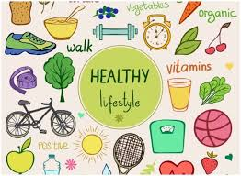
Introduction
Female sexual well-being is an important part of wellness that is often overlooked.
Studies show that approximately 40% of women will experience some type of sexual problem over the course of their lifetimes.
Despite this being a common concern for many women, they may be reluctant to discuss this part of their health with their health care providers.
A healthy lifestyle approach is one way to help overcome sexual problems.

Slide 3
Lifestyle issues
Stress
Exercise
Sleep
Nutrition
Habits
Communication

Slide 4
Stress
Perhaps not surprisingly, chronic stress has been shown to adversely affect sexual well-being.
Both psychological (distraction) and hormonal (increased cortisol) factors were related to the lower levels of sexual arousal seen in women high in chronic stress, but distraction was the only significant predictor when controlling for other variables.

Slide 5
Reduced Libido
Stress can significantly dampen sexual desire. The mental exhaustion and tension resulting from prolonged stress can lead to a decreased interest in sexual activity.
Infertility
The relationship between chronic stress and health problems like infertility is well-established. For instance, in women, stress can disrupt the menstrual cycle, while in men, it can affect sperm production. The anxiety surrounding infertility can further escalate stress levels, demonstrating a recurrent theme of how stress impacts health and sexual well-being.
Vaginismus
In women, stress can lead to vaginismus, making sexual intercourse painful or impossible. This condition is often linked to anxiety and past traumatic experiences, underscoring how stress can negatively affect sexual function and health.
Dyspareunia
Stress can also lead to dyspareunia. The pain can then cause anxiety about sexual activity, further exacerbating stress and leading to a cycle of health problems caused by stress.

Slide 6
Management
Mindfulness and Relaxation Techniques:
Meditation and Yoga: They can enhance your sexual experience by promoting body awareness and helping you stay present during sexual activity.
Breathing Exercises: Practicing deep breathing can help manage anxiety and stress, allowing for a calmer mind and a more relaxed body.
Progressive Muscle Relaxation: This technique involves tensing and then slowly releasing each muscle group in your body, starting with your toes and ending with your forehead. It can help reduce feelings of anxiety and promote a sense of calm, which can be beneficial for sexual health.

Slide 7
Management
Discussing Sexual Concerns: Openly discussing any sexual concerns and how stress is affecting your sexual health with your partner can foster understanding and a willingness to explore solutions together.
Therapy: Couples or individual therapy can provide a safe space to discuss stressors and work through any sexual health concerns.
Aerobic Exercise: Activities like jogging, swimming, or cycling can help mitigate the health effects of stress by promoting the release of endorphins, which are natural mood lifters.
Strength Training: Strength training exercises can also be effective in reducing stress and improving mood, which can, in turn, boost sexual health.
Dance: Engaging in dance can be a fun way to reduce stress and improve your mood and body confidence, which can enhance your sexual health.

Slide 8
Exercise
The benefits of exercise on both physical and mental health are well documented in the scientific literature and are frequently conveyed by popular media.
Improvements in physiological sexual arousal following acute exercise appear to be driven by increases in sympathetic nervous system activity and endocrine factors.
Exercise likely enhances sexual satisfaction indirectly by preserving autonomic flexibility, which benefits cardiovascular health and mood.

Slide 9
Exercise
Positive body image due to exercise also increases sexual well-being.
Exercise improves sexual function in depressed women not taking medication.
Women with anti-depressant-induced sexual dysfunction and women who have undergone hysterectomies can benefit from exercise.
One study found that in women with diagnosable sexual dysfunction, a regimen of 30 minutes of vigorous exercise 3 times a week was sufficient to produce clinically relevant improvements in sexual function, particularly sexual desire.

Slide 10
Sleep
Get Adequate Sleep: Quality sleep is crucial for overall health, including sexual function.
Poor sleep can lead to fatigue, irritability, and hormonal imbalances, all of which can affect libido and sexual performance.
Aim for 7-9 hours of uninterrupted sleep each night to support optimal sexual health and overall well-being.

Slide 11
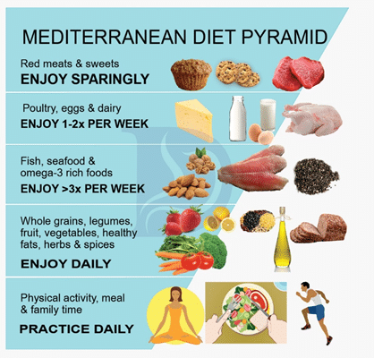
Nutrition
Achieving healthy dietary patterns is a core goal of sexual medicine.
The Mediterranean diet (MD) is the most widely studied in this context.
Its emphasis on vegetables, fruits, nuts, whole grains, legumes, olive oil, and fish makes it high in antioxidants and low in saturated fat and refined carbohydrates.

Slide 12
Nutrition
Decreasing sodium intake enhances the ability of vessels to dilate, with early evidence indicating direct impact on genital arousal.
Sufficient vessel dilation and engorgement are important preconditions for vaginal lubrication.
Additionally, consumption of soy, a phytoestrogen, is shown to support increased vaginal blood flow, lubrication, and vaginal collagen content and decreased dyspareunia.
As a suppressor of free-radical generation, the benefits of soy plausibly include an anti-inflammatory effect that enhances NO activity.

Slide 13
Fruits such as apples, watermelon, and cacao have been linked to enhanced vascular and sexual health.
Apples are high in polyphenols, other antioxidants, and phytoestrogens, which together support an anti-inflammatory and antiatherosclerogenic environment.
Watermelon in particular supports vascular health via an additional distinct mechanism.
It is a rich source of citrulline, which the body readily converts to the NO precursor, arginine.
Chocolate, derived from the cacao bean, is rich in flavonoids and has been found to increase NO-mediated vasodilation, with promise for supporting sexual function.
Meanwhile, evidence suggests that vitamin D and iron deficiencies are risk factors for sexual dysfunction, and resolution of these deficiencies may well be therapeutic.
Vitamin D receptors exist on the uterus and ovaries, where they can influence steroidogenesis and testosterone aromatization, with consequent effects on sex hormone levels.
In iron-deficiency anemia, fatigue is thought to mediate the relationship between deficiency and sexual dysfunction.
Testing for vitamin D and iron deficiency may be considered as a relatively simple and low-cost addition to the workup for female sexual dysfunction.

Slide 14
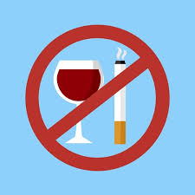
Habits
A few studies show that smoking was an independent risk factor of female sexual dysfunction and the cause may due to adversely affecting sexual arousal responses.
The impact of alcohol on sexual function is another important lifestyle consideration.
Research on alcohol and sexual arousal suggests that alcohol attenuates physiological sexual arousal, while increasing self-reported sexual arousal at low levels of intoxication and has no effect at higher levels of intoxication.
Substance abuse can exacerbate stress and lead to sexual health problems. Avoiding the misuse of substances like alcohol and drugs is crucial.

Slide 15
Communication
Communicate with Partner: Effective communication is essential for a satisfying sexual relationship.
Discussing desires, concerns, and boundaries openly with the partner fosters trust, intimacy, and mutual satisfaction.
Be willing to listen, express the needs, and work together to find solutions to any sexual challenges.
Engaging in hobbies and activities you enjoy can help divert your mind from stressors, promoting relaxation and happiness.
Protecting from sexually transmitted infections (STIs) is paramount for sexual health.
Consistently using condoms, getting tested regularly for STIs, and discussing sexual health with your partner are vital steps in maintaining sexual well-being.
If you’re experiencing persistent sexual difficulties or concerns, don’t hesitate to seek help from a healthcare provider or a qualified therapist.
They can offer guidance, support, and appropriate treatments to address any underlying issues and improve sexual health.

Slide 16
Case 1
61-year-old woman who came to see me to discuss low libido.
She would like to increase her sexual satisfaction.
Her past medical history is significant for lumbar degenerative disease, menopause, and depression.
Her medications include Citalopram, and ibuprofen as needed for her back pain.
Her past surgical history includes a hysterectomy due to fibroids.
She went into menopause at age 49 years.
She describes that she has a good relationship with her husband. She does not smoke.
On sexual history, she is sexually active with her husband. She describes that she often has vaginal pain with intercourse.
Also, at times she has exacerbation of her back pain during intercourse.
Her sexual desire has decreased recently over the past 5 to 10 years and she is not easily aroused. She is able to achieve an orgasm infrequently.

Slide 17
Case 1
She found lifestyle changes that improved her sexual well-being.
She benefited from exercising, yoga, and stress management.
For her, addressing her lumbar back pain and her vaginal atrophy that were contributing to painful intercourse augmented her sexual satisfaction.
These lifestyle changes made a difference for her by improving not only her low sexual desire but also her intimate connection with her husband.

Slide 18
Case 2
A 40-year-old woman, struggles with sexual arousal and discomfort during intercourse.
She has a sedentary lifestyle and is overweight.

Slide 19
Case 2
Lifestyle Modifications:
Balanced Diet:
Nutrient-Rich Foods: She adopts a balanced diet rich in fruits, vegetables, whole grains, and lean proteins.
This helps her lose weight and improve her overall health.
A healthy diet can enhance sexual function by improving blood flow, hormone levels, and energy.
Hydration: Staying well-hydrated is essential for overall health and can improve vaginal lubrication, reducing discomfort during intercourse.

Slide 20
Case 2
Weight Management:
Regular Exercise
Behavioral Changes: She works with a nutritionist to develop a sustainable weight management plan.
This includes setting realistic goals, tracking progress, and making gradual changes to her lifestyle.
Outcome: As her overall health improves, she experiences better blood flow and increased sensitivity, leading to enhanced sexual arousal and reduced discomfort during intercourse.
Her confidence and self-esteem also improve, positively impacting her sexual relationships.

Slide 21
Category: Fertility Booster in Men

Slide 22
Reactive Oxygen Species (ROS) and Male Fertility
ROS are mainly produced as metabolic by-products during mitochondrial respiration and various enzymatic reactions.
As spermatozoa mature and capacitate, there is a surge in ROS generation that under the controlled and balanced conditions are beneficial. An excessive amount of ROS produced by sperm cells can cause oxidative damage to their membranes, DNA, and other cellular components, leading to:
Decreased sperm motility, reduced viability, and a diminished potential for fertilization.
1- Kaltsas A. Medicina. 2023 Oct 4;59(10):1769.
2- Aitken, R.J. et al. Male Antioxidants 2022, 11, 306.
22

Slide 23
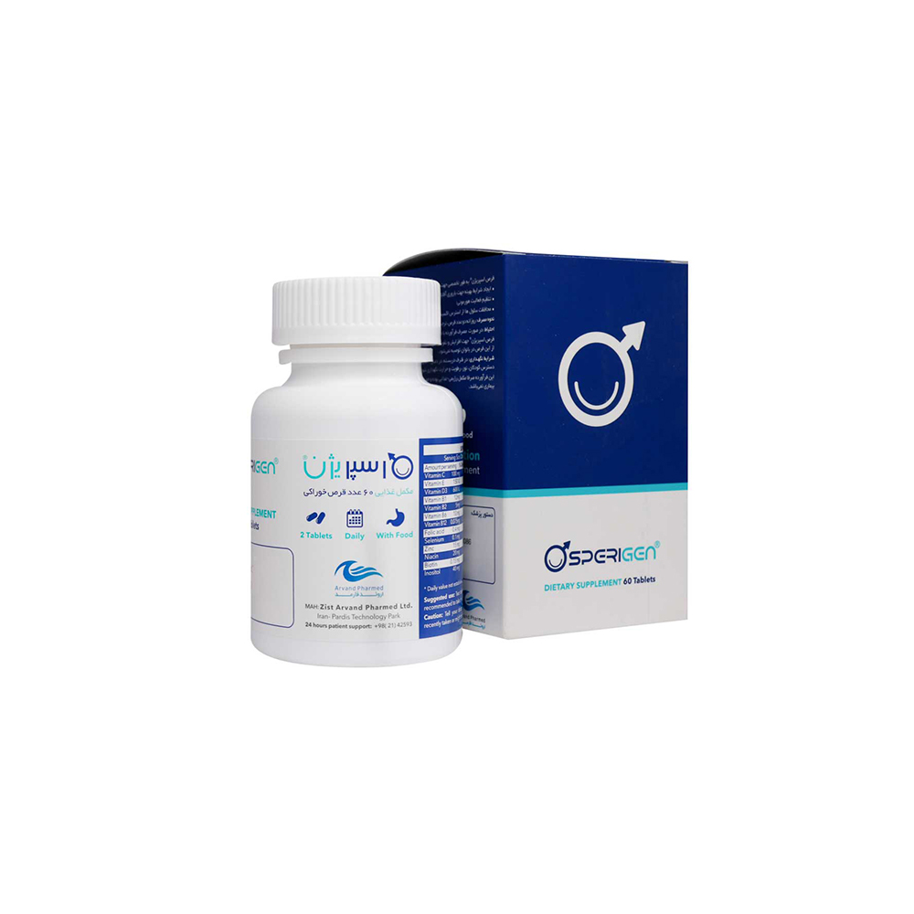
SUPPLEMENT FACTS
Ingredients | Amount per Serving | % Daily Value | Ingredients | Amount per Serving | % Daily Value
Vitamin C | 100 mg | 111.11 | Magnesium Oxide | 60 mg | 14.28
Vitamin E | 150 IU | 450 | Glutathione | 2.5 mg | *
Vitamin D3 | 600 IU | 75 | Iron (as fumarate) | 6 mg | 33
Vitamin B1 | 12 mg | 1000 | Copper Gluconate | 1 mg | 111
Vitamin B2 | 5 mg | 385 | L-Carnitine | 200 mg | *
Vitamin B6 | 10 mg | 588 | Manganese (as Gluconate) | 2 mg | 87
Vitamin B12 | 0.075 mg | 3125 | Chromium | 0.05 mg | 143
Folic Acid | 0.4 mg | 100 | Coenzyme Q10 | 15 mg | *
Sodium Selenite | 0.1 mg | 181.82 | L-Arginine | 10 mg | *
Zinc (as oxide) | 15 mg | 136.36 | Pantothenic acid | 10 mg | 200
Niacin | 20 mg | 125 | N-Acetyl-L-Cysteine | 50 mg | *
Biotin | 0.15 mg | 500 | Lycopene | 4 mg | *
Inositol | 40 mg | * | Siberian Ginseng root extract | 30 mg | *
Vitamin A | 5000 IU | 167
23

Slide 24
SUPPLEMENT FACTS
Ingredients | Amount per Serving | % Daily Value | Ingredients | Amount per Serving | % Daily Value
Vitamin C | 100 mg | 111.11 | Magnesium Oxide | 60 mg | 14.28
Vitamin E | 150 IU | 450 | Glutathione | 2.5 mg | *
Vitamin D3 | 600 IU | 75 | Iron (as fumarate) | 6 mg | 33
Vitamin B1 | 12 mg | 1000 | Copper Gluconate | 1 mg | 111
Vitamin B2 | 5 mg | 385 | L-Carnitine | 200 mg | *
Vitamin B6 | 10 mg | 588 | Manganese (as Gluconate) | 2 mg | 87
Vitamin B12 | 0.075 mg | 3125 | Chromium | 0.05 mg | 143
Folic Acid | 0.4 mg | 100 | Coenzyme Q10 | 15 mg | *
Sodium Selenite | 0.1 mg | 181.82 | L-Arginine | 10 mg | *
Zinc (as oxide) | 15 mg | 136.36 | Pantothenic acid | 10 mg | 200
Niacin | 20 mg | 125 | N-Acetyl-L-Cysteine | 50 mg | *
Biotin | 0.15 mg | 500 | Lycopene | 4 mg | *
Inositol | 40 mg | * | Siberian Ginseng root extract | 30 mg | *
Vitamin A | 5000 IU | 167
Sperigen® is a nutritional supplement designed for:
Supporting reproductive health in men
Protecting the cells (and especially sperms) from oxidative stress
Regulating the hormonal activities
Serving Size: 2 tablets
1 in the morning and 1 in the evening
With meal
24

Slide 25
Sperigen® is a nutritional supplement designed for:
Supporting reproductive health in men
Protecting the cells (and especially sperms) from oxidative stress
Regulating the hormonal activities
Serving Size: 2 tablets
1 in the morning and 1 in the evening
With meal
SUPPLEMENT FACTS
Ingredients | Amount per Serving | % Daily Value | Ingredients | Amount per Serving | % Daily Value
Vitamin C | 100 mg | 111.11 | Magnesium Oxide | 60 mg | 14.28
Vitamin E | 150 IU | 450 | Glutathione | 2.5 mg | *
Vitamin D3 | 600 IU | 75 | Iron (as fumarate) | 6 mg | 33
Vitamin B1 | 12 mg | 1000 | Copper Gluconate | 1 mg | 111
Vitamin B2 | 5 mg | 385 | L-Carnitine | 200 mg | *
Vitamin B6 | 10 mg | 588 | Manganese (as Gluconate) | 2 mg | 87
Vitamin B12 | 0.075 mg | 3125 | Chromium | 0.05 mg | 143
Folic Acid | 0.4 mg | 100 | Coenzyme Q10 | 15 mg | *
Sodium Selenite | 0.1 mg | 181.82 | L-Arginine | 10 mg | *
Zinc (as oxide) | 15 mg | 136.36 | Pantothenic acid | 10 mg | 200
Niacin | 20 mg | 125 | N-Acetyl-L-Cysteine | 50 mg | *
Biotin | 0.15 mg | 500 | Lycopene | 4 mg | *
Inositol | 40 mg | * | Siberian Ginseng root extract | 30 mg | *
Vitamin A | 5000 IU | 167
Sperigen, by a comprehensive combination of essential trace elements, vitamins and antioxidants, not only improves sperm parameters and consequently improves fertility, but also provides the required nutrients for general health in men.
25

Slide 26
Category: Fertility Booster in Women

Slide 27
Meet Our
CEO
The prevalence of female, male, both, and unexplained causes was estimated to be 32.0% (95% CI: 27.6-36.8), 43.3% (95% CI: 38.2-48.6), 12.5% (95% CI: 9.6-16.2), and 13.6% (95% CI: 10.2-17.8), respectively.
5
Abangah GH, et al. Int J Fertil Steril. 2023 Apr.
Notes:
Abangah GH, Rashidian T, Parizad Nasirkandy M, Azami M. A Meta-Analysis of The Prevalence and Etiology of Infertility in Iran. Int J Fertil Steril. 2023 Apr 1;17(3):160-173. doi: 10.22074/ijfs.2023.541991.1215. PMID: 37183842; PMCID: PMC10189156.

Slide 28
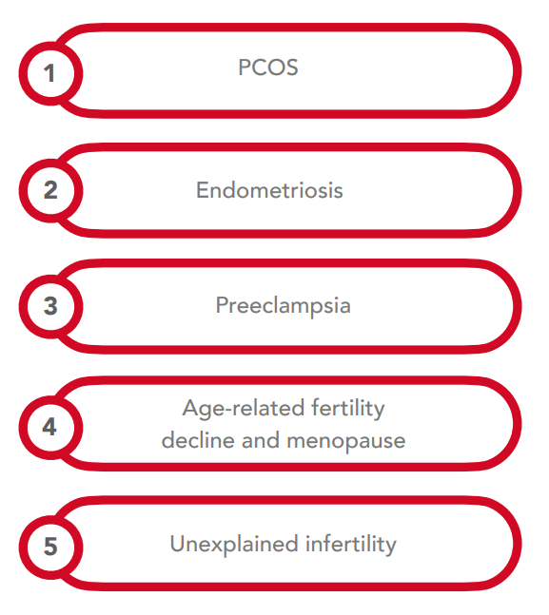
Oxidative Stress and Female Infertility
Factors that can cause oxidative stress
Impact of oxidative stress in female reproduction
Obesity
Undernutrition
Cigarette smoking
Alcohol and drug use
Environmental pollution
13
Agarwal A, et al. Reproductive Biology and Endocrinology. 2012.
Notes:
Agarwal A, Aponte-Mellado A, Premkumar BJ, Shaman A, Gupta S. The effects of oxidative stress on female reproduction: a review. Reproductive Biology and Endocrinology. 2012;10(1):49.

Slide 29
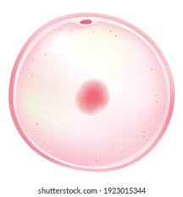
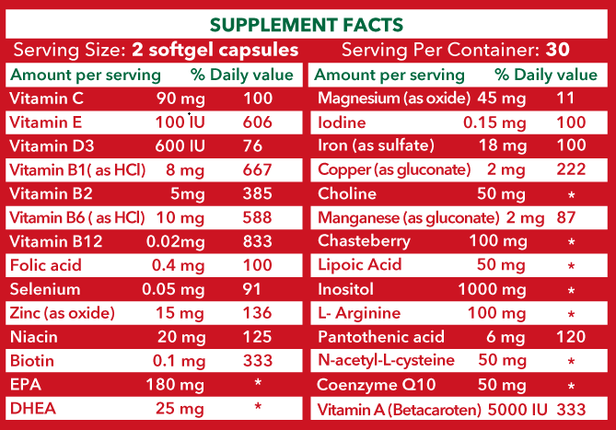
Supplement Facts
50

Slide 30
Serving size: 2 softgels daily
Best taken with food
60 softgels per container
51

Slide 31
Supports reproductive health in women.
Helps to improve the symptoms caused by polycystic ovary syndrome and endometriosis.
Enhances egg quality.
02
04
06
01
03
05
Supplies vitamins and minerals necessary for women who are planning pregnancy.
Regulates the hormonal activity.
Improves women’s fertility potential.
52

